Slide 1
Radioelektron tizimlar va axborot техnologiyalari markazi
DISSERTATSIYA
Mavzu: “AES algoritmini chiziqli kriptotahlil usuliga bardoshligini baholash va uning dasturiy ta’minotini yaratish”
Ilmiy rahbar: f.m.f.n. Kur’yazov D. M.
Dissertant: Mayliyev O. I.

Slide 2
Mavzuning dolzarbligi
Axborotni kriptografik va texnik himoya qilish vositalarini yaratish bo’yicha 2011 – 2015 yillarga mo’ljallangan “ilmiy tadqiqot va tajriba konstruktorlik ishlari” rejasiga asosan kriptografik algoritmlar bardoshligini baholash yo’nalishi bo’yicha ilmiy tadqiqot ishlarini olib borish nazarda tutilgan. Shundan kelib chiqib standart simmetrik shifrlash algoritmlari kriptotahlili mavzusida ilmiy tadqiqot ishlarini olib borish dolzarb hisoblanadi.

Slide 3
Mavzuning o’rganilganlik darajasi
1993 yil M. Matsui tamonidan DES algoritmiga nisbatan chiziqli kriptotahlil qo’llanilgan.
2001 yilda V. V. Sholin, V. V. Jeleznyakov, E. M. Gabidulin tamonidan GOST28147-89 algoritmi 5-raundidan boshlab chiziqli kriptotahlil usuliga, 7-raundidan boshlab differentsial kriptotahlil usuliga bardoshligi masalalari ko’rib chiqilgan.
2009 yilda magistrant Ahmadaliyev A. R. tamonidan DES algoritmi S bloklari uchun chiziqli kripotahlil o’tkazish bo’yicha tegishli natijalar olingan.
2010 yilda magistrant Aliqulov B. M. tamonidan DES algoritmi bitta raundi va GOST 28147-89 algoritmi S bloklari hamda SP tarmog’iga asoslangan 9 bit kirish va 9 bit chiqishga ega bo’lgan 3 raundli shifrlash algoritmi uchun chiziqli kripotahlil o’tkazish bo’yicha tegishli natijalar olingan.
AES algoritmini qabul qilish bo’yicha o’tkazilgan tanlov[http://csrc.nist.gov/encryption/aes] xulosalariga ko’ra uning chiziqli kriptotahlil usuliga bardoshliligi haqida ma’lumotlar keltirilgan.
AES shifrlash algoritmi “Kvadrat” arxitekturasi va “mumkin bo’lmagan differentsiallar” deb ataluvchi yangi kriptotahlil usullariga tekshirilib tegishli natijalar olingan.

Slide 4
Tadqiqot maqsadi
AES standart va AES o’quv simmetrik shifrlash algoritmlarini chiziqli kriptotahlil usuliga bardoshligini baholash va uning dasturiy ta’minotini yaratish (1,2,3 – raundlar misolida).

Slide 5
Maqsaddan kelib chiquvchi vazifalar
SP tarmog’iga asoslangan shifrlash algoritmlari uchun chiziqli kriptotahlil usuli tahlili
1
AES simmetrik shifrlash algoritmi uchun chiziqli kriptotahlil usulining qo’llanilishi
2
AES simmetrik shifrlash algoritmi uchun chiziqli kriptotahlil usuliga dasturiy ta’minot yaratish
3
AES simmetrik shifrlash algoritmiga chiziqli kriptotahlil usuli uchun yaratilgan dasturiy ta’minotidan olingan natijalar tahlili
4

Slide 6
I BOB
SP tarmog’iga asoslangan shifrlash algoritmlari uchun chiziqli kriptotahlil usuli tahlili
1.1
AES shifrlash algoritmi va uni umumiy kriptografik talablarga tekshirish
1.2
SP tarmog’iga asoslangan 9 bit kirish va 9 bit chiqishga ega bo’lgan simmetrik shifrlash algoritmi uchun chiziqli kriptotahlil usuli

Slide 7
SubBytes() va SubBytes*() akslantirishlarini umumiy kriptografik talablarga tekshirish
AES | SubBytes()
 | f₁ | f₂ | f₃ | f₄ | f₅ | f₆ | f₇ | f₈
argumentlari | 8
balanslashganlik | + | + | + | + | + | + | + | +
reguryarlik | +
deg (f) | 7 | 7 | 7 | 7 | 7 | 7 | 7 | 7
N (f) | 112 | 112 | 112 | 112 | 112 | 112 | 112 | 112
N (φ) | 112
CI(f) | 0 | 0 | 0 | 0 | 0 | 0 | 0 | 0
SAC(f) | 6 | 8 | 8 | 8 | 8 | 6 | 6 | 6
X | Y
 | 0 | 1 | 2 | 3 | 4 | 5 | 6 | 7 | 8 | 9 | a | b | c | d | e | f
0 | 63 | 7c | 77 | 7b | 12 | 6b | 6f | c5 | 30 | 01 | 67 | 2b | fe | d7 | ab | 76
1 | ca | 82 | c9 | 7d | fa | 59 | 47 | f0 | ad | d4 | a2 | af | 9c | a4 | 72 | c0
2 | b7 | fd | 93 | 26 | 36 | 3f | f7 | cc | 34 | a5 | e5 | f1 | 71 | d8 | 31 | 15
3 | 04 | c7 | 23 | c3 | 18 | 96 | 05 | 9a | 07 | 12 | 80 | e2 | eb | 27 | b2 | 75
4 | 09 | 83 | 2c | 1a | 1b | 62 | 5a | a0 | 52 | 3b | d6 | b3 | 29 | e3 | 2f | 84
5 | 53 | d1 | 00 | ed | 20 | fc | b1 | 5b | 6a | cb | be | 39 | 4a | 4c | 58 | cf
6 | d0 | ef | aa | fb | 43 | 4d | 33 | 85 | 45 | f9 | 02 | 7f | 50 | 3c | 9f | a8
7 | 51 | a3 | 40 | 8f | 92 | 9d | 38 | f5 | bc | b6 | da | 21 | 10 | ff | f3 | d2
8 | cd | 0c | 13 | ec | 5f | 97 | 44 | 17 | c4 | a7 | 7e | 3d | 64 | 5d | 18 | 73
9 | 60 | 81 | 4f | dc | 22 | 2a | 90 | 88 | 46 | ee | b8 | 14 | de | 5e | 0b | db
a | e0 | 32 | 3a | 0a | 49 | 06 | 24 | 5c | c2 | d3 | ac | 62 | 91 | 95 | e4 | 79
b | e7 | c8 | 37 | 6d | 8d | d5 | 4e | a9 | 6c | 56 | f4 | ea | 65 | 7a | ae | 08
c | ba | 78 | 25 | 2e | 1c | a6 | b4 | c6 | e8 | dd | 74 | 1f | 4d | bd | 8b | 8a
d | 70 | 3e | b5 | 66 | 48 | 03 | f6 | 0e | 61 | 35 | 57 | b9 | 86 | c1 | 1d | 9e
e | e1 | f8 | 98 | 11 | 69 | d9 | 8e | 94 | 9b | 1e | 87 | e9 | ce | 55 | 28 | df
f | 8c | a1 | 89 | 0d | bf | e6 | 42 | 68 | 41 | 99 | 2d | 0f | b0 | 54 | bb | 16
№ | 0 | 1 | 2 | 3 | 4 | 5 | 6 | 7 | 8 | 9 | a | b | c | d | e | f
0 | 179 | 165 | 25 | 41 | 122 | 173 | 33 | 19 | 203 | 55 | 27 | 166 | 143 | 54 | 188 | 83
1 | 199 | 9 | 70 | 38 | 230 | 127 | 95 | 141 | 46 | 23 | 214 | 182 | 232 | 140 | 153 | 3
2 | 215 | 130 | 86 | 138 | 116 | 14 | 253 | 101 | 52 | 6 | 217 | 167 | 164 | 118 | 218 | 120
3 | 193 | 48 | 65 | 85 | 40 | 114 | 17 | 190 | 251 | 93 | 45 | 221 | 22 | 131 | 13 | 77
4 | 160 | 2 | 208 | 145 | 224 | 50 | 212 | 187 | 20 | 42 | 76 | 104 | 147 | 250 | 72 | 108
5 | 207 | 74 | 62 | 177 | 186 | 103 | 170 | 235 | 137 | 90 | 254 | 71 | 226 | 24 | 134 | 106
6 | 163 | 88 | 162 | 191 | 1 | 18 | 242 | 109 | 144 | 117 | 49 | 255 | 107 | 97 | 183 | 43
7 | 206 | 125 | 222 | 26 | 194 | 119 | 135 | 154 | 129 | 244 | 47 | 91 | 139 | 209 | 132 | 64
8 | 161 | 29 | 216 | 99 | 239 | 169 | 136 | 87 | 66 | 246 | 59 | 245 | 151 | 211 | 111 | 44
9 | 63 | 79 | 4 | 172 | 121 | 73 | 228 | 155 | 15 | 84 | 210 | 200 | 149 | 81 | 61 | 89
a | 213 | 180 | 197 | 7 | 36 | 110 | 35 | 112 | 69 | 174 | 229 | 249 | 201 | 57 | 142 | 220
b | 28 | 123 | 156 | 21 | 37 | 124 | 248 | 102 | 126 | 205 | 51 | 94 | 157 | 12 | 178 | 11
c | 243 | 233 | 231 | 53 | 247 | 196 | 236 | 148 | 185 | 67 | 176 | 234 | 105 | 100 | 204 | 8
d | 181 | 168 | 158 | 113 | 133 | 150 | 5 | 78 | 237 | 80 | 30 | 34 | 238 | 192 | 146 | 31
e | 202 | 184 | 82 | 60 | 92 | 68 | 198 | 240 | 195 | 98 | 58 | 223 | 16 | 241 | 175 | 152
f | 96 | 75 | 227 | 32 | 219 | 128 | 189 | 0 | 115 | 10 | 56 | 39 | 225 | 171 | 159 | 252
AES | SubBytes*()
 | f₁ | f₂ | f₃ | f₄ | f₅ | f₆ | f₇ | f₈
argumentlari | 8
balanslashganlik | + | + | + | + | + | + | + | +
reguryarlik | + | + | + | + | + | + | + | +
deg (f) | 7 | 7 | 7 | 7 | 7 | 7 | 7 | 7
N (f) | 102 | 106 | 102 | 102 | 100 | 106 | 104 | 98
N (φ) | 92
CI(f) | 0 | 0 | 0 | 0 | 0 | 0 | 0 | 0
SAC(f) | 8 | 4 | 16 | 12 | 12 | 8 | 12 | 16

Slide 8
SP tarmog’iga asoslangan 9 bit kirish va 9 bit chiqishga ega bo’lgan simmetrik shifrlash algoritmi uchun chiziqli kriptotahlil usuli
S blok akslantirish
O’rin almashtirish akslantirish
Kirish | 0 | 1 | 2 | 3 | 4 | 5 | 6 | 7
Chiqish | 7 | 1 | 4 | 0 | 6 | 2 | 5 | 3
1 | 2 | 3 | 4 | 5 | 6 | 7 | 8 | 9
1 | 4 | 7 | 2 | 5 | 8 | 3 | 6 | 9
X₁
Ochiq matn
X₉
К kalit bilan qo’shish
K₉
X₉
Korrelyatsion matritsa jadvali
U₁₉
№ | Kirish bitlari | Chiqish bitlari
1 | X₉ | S₃₁ bloklarning chiqishi 010, 011 vа 110 ga teng
j | 1 | 2 | 3 | 4 | 5 | 6 | 7
i
1 | 4 | 4 | 4 | 0 | 4 | 4 | 4
2 | 4 | 2 | 2 | 4 | 4 | 6 | 2
3 | 4 | 2 | 6 | 4 | 4 | 6 | 6
4 | 4 | 6 | 6 | 4 | 4 | 6 | 2
5 | 4 | 2 | 6 | 4 | 4 | 2 | 2
6 | 0 | 4 | 4 | 4 | 4 | 4 | 4
7 | 4 | 4 | 4 | 4 | 8 | 4 | 4
S₁₁
S₁₂
S₁₃
V₁₇
1-r
V₁₇
K₃
V₁₇
К kalit bilan qo’shish
Birinchi raund uchun:
U₁₉=K₉+X₉, V₁₇=U₁₉, p₁=0
2. Ikkinchi raund uchun:
U₂₃=K₃+V₁₇, V₂₁=U₂₃, p₂=0
U₂₃
S₂₁
S₂₂
S₂₃
V₂₁
2-r
3. Uchinchi raund uchun:
U₃₁=K₁+V₂₁, V₃₂=U₃₁, p₃=3/4
Y₂=K₂+V₃₂
4. Aproksimatsiya tenglamalari:
Y₂+X₉=K₁+K₂+K₃+K₉ P=3/4
Y₂+X₃+X₉=K₁+K₂+K₉ P=3/4
Y₁+Y₂+X₃+X₉=K₁+K₂+K₉ P=3/4
K₁
V₂₁
К kalit bilan qo’shish
U₃₁
S₃₁
S₃₂
S₃₃
V₃₂
3-r
K₂
V₃₂
К kalit bilan qo’shish
Y₁
Shifr matn
Y₉

Slide 9
II BOB
AES simmetrik shifrlash algoritmi uchun chiziqli kriptotahlil usulining qo’llanilishi
2.1
AES o’quv algoritm uchun chiziqli kriptotahlil usulini o’tkazish
2.2
AES shifrlash algoritmi SubBytes() akslantirishi uchun chiziqli kriptotahlil usuli
2.3
AES shifrlash algoritmi uchun chiziqli kriptotahlil usuli

Slide 10
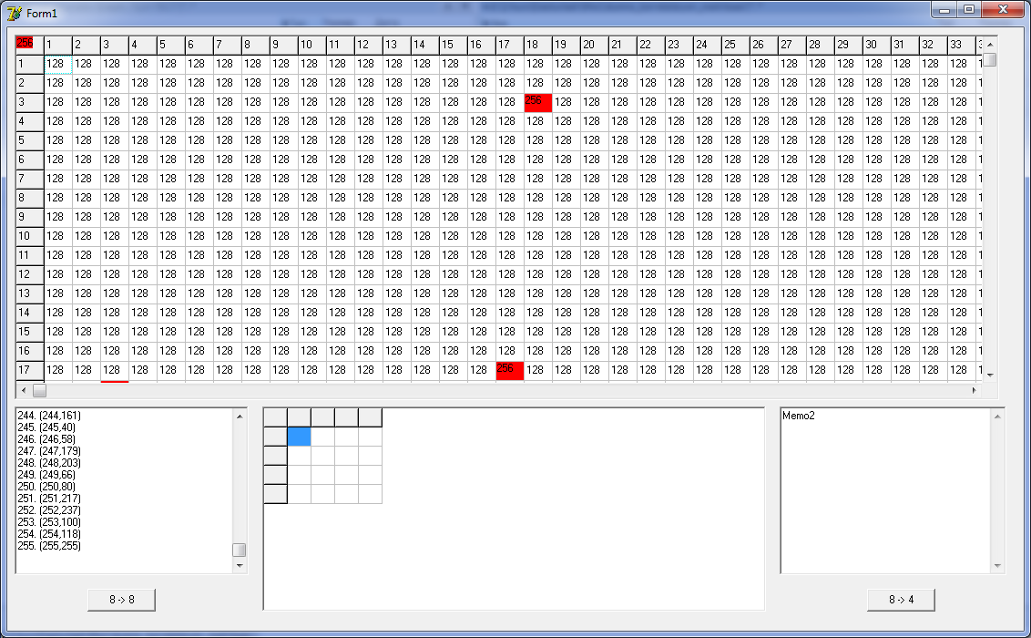
AES o’quv algoritmi uchun chiziqli kriptotahlil usulini o’tkazish
SubBytes() akslantirishi
MixColumns() akslantirishi
Kirish | 0 | 1 | 2 | 3 | 4 | 5 | 6 | 7 | 8 | 9 | 10 | 11 | 12 | 13 | 14 | 15
Chiqish | 9 | E | 5 | 1 | 8 | B | D | A | 6 | 7 | F | 3 | C | 4 | 0 | 2
j i | 1 | 2 | 3 | 4 | 5 | 6 | 7 | 8 | 9 | 10 | 11 | 12 | 13 | 14 | 15
1 | 8 | 12 | 8 | 6 | 10 | 10 | 10 | 6 | 10 | 6 | 6 | 8 | 8 | 8 | 12
2 | 10 | 8 | 10 | 6 | 4 | 10 | 8 | 6 | 8 | 6 | 8 | 4 | 10 | 8 | 6
3 | 10 | 8 | 6 | 12 | 6 | 8 | 6 | 8 | 6 | 4 | 6 | 8 | 6 | 8 | 10
4 | 4 | 6 | 6 | 6 | 6 | 12 | 8 | 10 | 6 | 8 | 8 | 8 | 8 | 6 | 10
5 | 8 | 6 | 6 | 8 | 8 | 6 | 6 | 8 | 12 | 10 | 6 | 4 | 8 | 6 | 10
6 | 10 | 6 | 4 | 8 | 10 | 10 | 8 | 8 | 10 | 6 | 12 | 8 | 10 | 10 | 8
7 | 6 | 10 | 8 | 10 | 4 | 8 | 10 | 10 | 12 | 8 | 10 | 8 | 6 | 10 | 8
8 | 6 | 10 | 4 | 10 | 8 | 8 | 10 | 4 | 6 | 10 | 8 | 6 | 8 | 8 | 6
9 | 6 | 10 | 8 | 8 | 10 | 6 | 8 | 10 | 8 | 4 | 10 | 6 | 8 | 4 | 6
10 | 8 | 6 | 10 | 12 | 8 | 10 | 10 | 6 | 10 | 8 | 8 | 10 | 10 | 4 | 8
11 | 8 | 10 | 10 | 10 | 10 | 12 | 4 | 8 | 8 | 10 | 10 | 6 | 6 | 8 | 8
12 | 10 | 12 | 6 | 8 | 6 | 8 | 6 | 10 | 8 | 10 | 8 | 10 | 12 | 6 | 8
13 | 6 | 8 | 10 | 10 | 8 | 6 | 8 | 8 | 6 | 8 | 10 | 6 | 12 | 10 | 12
14 | 8 | 8 | 8 | 6 | 6 | 6 | 6 | 4 | 8 | 8 | 12 | 10 | 6 | 6 | 10
15 | 4 | 8 | 8 | 8 | 8 | 8 | 4 | 6 | 10 | 6 | 6 | 10 | 10 | 10 | 6
SubBytes() uchun korrelyatsion matritsa jadvali
Bu jadvalda 8 dan eng katta chetlanishga ega bo’lgan vektorlar qaraladi
MixColumns() uchun korrelyatsion matritsa jadvali

Slide 11
Shunga o'xshash yuqoridagi jadvalda keltirilgan algoritmga kiruvchi ochiq matn pozitsiyalariga nisbatan ham aproksimatsiya tenglamalari yuqorida qadamlar ketma – ketligida quriladi. Ya’ni:
X₁
Ochiq matn
X₁₆
K kalit bitini qo’shish
S₁₁
S₁₂
S₁₃
S₁₄
№ | Kirish biti | Kirish, chiqish va kalit bitlari | P
1 | X₁ | X[1]⊕Y[2,4,15]=K[1,2,3,4,8,15] | 0.5625
2 | X₁, X₂ | X[1,2]⊕Y[2,3,13,15]=K[4,5,8,13,15] | 0.4375
3 | X₁, X₂, X₃ | X[1,2,3]⊕Y[3,16]=K[6,16] | 0.5625
4 | X₁₀ | X[10]⊕Y[6,8,11,12]=K[6,8,15] | 0.4375
5 | X₉, X₁₁ | X[9,11]⊕Y[6,7,11,12]=K[6,7,9,10,11,12,15] | 0.5625
6 | X₉, X₁₁,X₁₂ | X[9,11,12]⊕Y[6,7,13,15,16]=K[6,7,10,11] | 0.5625
7 | X₅,X₇ | X[5,7]⊕Y[7,8,10,12]=K[5,8,10,11,12,14,15] | 0.5625
8 | X₅,X₆,X₇ | X[5,6,7]⊕Y[7,12]=K[5,6,10,12,13,14] | 0.5625
9 | X₅,X₈ | X[5,8]⊕Y[6,8,9,10,12]=K[5,6,14,15,16] | 0.5625
10 | X₁₃,X₁₄,X₁₅,X₁₆ | X[13,14,15,16]⊕Y[3,7,13,15]=K[1,3,4,5,8,14,16] | 0.5625
11 | X₁₄,X₁₅,X₁₆ | X[14,15,16]⊕Y[2,16]=K[1,2,3,5,6,7,8,14,15] | 0.5625
12 | X₃,X₁₅,X₁₆ | X[3,15,16]⊕Y[1,2,3,4,15]= K[5,6,16] | 0.4687
13 | X₆,X₇,X₁₂ | X[6,7,12]⊕Y[6,7,10]=K[7,9,10,11,12,13,15,16] | 0.4687
14 | X₁,X₁₃ | X[1,13]⊕Y[2,14]=K[1,2,3,4,7,8,13,14] | 0.5312
15 | X₁,X₅ | X[1,5]⊕Y[2,4,6,8,11,15]=K[1,2,3,4,5,6,11,12] | 0.5039
16 | X₁₆ | X[16]⊕Y[1,3,14,15,16]=K[3,4,5,7,8,14,15] | 0.5625
1 - r
ShiftRows()
MixColumns()(P₁)
MixColumns()(P₂)
K kalit bitini qo’shish
S₂₁
S₂₂
S₂₃
S₂₄
2 - r
ShiftRows()
K kalit bitini qo’shish
Y₁
Shifr matn
Y₁₆

Slide 12

Yuqorida bayon qilingan fikrlardan kelib chiqib, SP-tarmog’i uchun chiziqli kriptotahlil o'tkazish jarayoni shifrlash algoritmida foydalanilgan raund kalitlaridan qandaydir bitlarini topish imkoniyatini beradi. Haqiqiy kalit bitlarini tanlab olish chiziqli kriptotahlil usulida tuzilgan tenglamalarning extimolligidan, tanlangan ochiq matn va unga mos shifr matndan kelib chiqib, quyidagi algoritmga asoslanib tenglamalar tuziladi.
1. K₁⊕K₂⊕K₃⊕K₄⊕K₈ ⊕K₁₅ = 1 | 9. K₅⊕K₆⊕K₁₄⊕K₁₅⊕K₁₆ = 0
2. K₄⊕K₅⊕K₈⊕K₁₃⊕K₁₅ = 1 | 10. K₁⊕K₃⊕K₄⊕K₅⊕K₈⊕K₁₄⊕K₁₆ = 1
3. K₆⊕K₁₆ = 0 | 11. K₁⊕K₂⊕K₃⊕K₅⊕K₆⊕K₇⊕K₈⊕K₁₄⊕K₁₅ = 0
4. K₆⊕K₈⊕K₁₅ = 1 | 12. K₅⊕K₆⊕K₁₆ = 1
5. K₆⊕K₇⊕K₉⊕K₁₀⊕K₁₁⊕K₁₂⊕K₁₅ = 1 | 13. K₇⊕K₉⊕K₁₀⊕K₁₁⊕K₁₂⊕K₁₃⊕K₁₅⊕K₁₆ = 1
6. K₆⊕K₇⊕K₁₀⊕K₁₁ = 0 | 14. K₁⊕K₂⊕K₃⊕K₄⊕K₇⊕K₈⊕K₁₃⊕K₁₄ = 1
7. K₅⊕K₈⊕K₁₀⊕K₁₁⊕K₁₂⊕K₁₄⊕K₁₅ = 0 | 15. K₁⊕K₂⊕K₃⊕K₄⊕K₅⊕K₆⊕K₁₁⊕K₁₂ = 0
8. K₅⊕K₆⊕K₁₀⊕K₁₂⊕K₁₃⊕K₁₄ = 1 | 16. K₃⊕K₄⊕K₅⊕K₇⊕K₈⊕K₁₄⊕K₁₅ = 0
Natijada kalitning quyidagi to’rtta variant hosil bo’ladi:
K¹ = 0000100011101010₂
K² = 0011101001010010₂
K³ = 1101110110101011₂
K⁴ = 0100111110010011₂
Bu kalitlar bilan berilgan ochiq matn shifrlanadi, olingan natijani berilgan ochiq matnga mos shifr matn bilan tenglashtiriladi va haqiqiy kalit aniqlanadi.
Demak, haqiqiy kalit K = 0000100011101010₂ ekanligi aniqlandi.

Slide 13
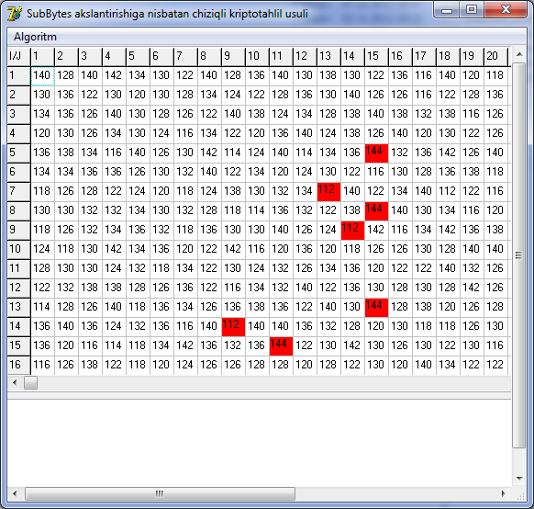
AES shifrlash algoritmi SubBytes() akslantirishi uchun chiziqli kriptotahlil usuli
X | Y
 | 0 | 1 | 2 | 3 | 4 | 5 | 6 | 7 | 8 | 9 | a | b | c | d | e | f
0 | 63 | 7c | 77 | 7b | 12 | 6b | 6f | c5 | 30 | 01 | 67 | 2b | fe | d7 | ab | 76
1 | ca | 82 | c9 | 7d | fa | 59 | 47 | f0 | ad | d4 | a2 | af | 9c | a4 | 72 | c0
2 | b7 | fd | 93 | 26 | 36 | 3f | f7 | cc | 34 | a5 | e5 | f1 | 71 | d8 | 31 | 15
3 | 04 | c7 | 23 | c3 | 18 | 96 | 05 | 9a | 07 | 12 | 80 | e2 | eb | 27 | b2 | 75
4 | 09 | 83 | 2c | 1a | 1b | 62 | 5a | a0 | 52 | 3b | d6 | b3 | 29 | e3 | 2f | 84
5 | 53 | d1 | 00 | ed | 20 | fc | b1 | 5b | 6a | cb | be | 39 | 4a | 4c | 58 | cf
6 | d0 | ef | aa | fb | 43 | 4d | 33 | 85 | 45 | f9 | 02 | 7f | 50 | 3c | 9f | a8
7 | 51 | a3 | 40 | 8f | 92 | 9d | 38 | f5 | bc | b6 | da | 21 | 10 | ff | f3 | d2
8 | cd | 0c | 13 | ec | 5f | 97 | 44 | 17 | c4 | a7 | 7e | 3d | 64 | 5d | 18 | 73
9 | 60 | 81 | 4f | dc | 22 | 2a | 90 | 88 | 46 | ee | b8 | 14 | de | 5e | 0b | db
a | e0 | 32 | 3a | 0a | 49 | 06 | 24 | 5c | c2 | d3 | ac | 62 | 91 | 95 | e4 | 79
b | e7 | c8 | 37 | 6d | 8d | d5 | 4e | a9 | 6c | 56 | f4 | ea | 65 | 7a | ae | 08
c | ba | 78 | 25 | 2e | 1c | a6 | b4 | c6 | e8 | dd | 74 | 1f | 4d | bd | 8b | 8a
d | 70 | 3e | b5 | 66 | 48 | 03 | f6 | 0e | 61 | 35 | 57 | b9 | 86 | c1 | 1d | 9e
e | e1 | f8 | 98 | 11 | 69 | d9 | 8e | 94 | 9b | 1e | 87 | e9 | ce | 55 | 28 | df
f | 8c | a1 | 89 | 0d | bf | e6 | 42 | 68 | 41 | 99 | 2d | 0f | b0 | 54 | bb | 16
Quyidagi keltirilgan SubBytes() akslantirishini quyidagi formula orqali korrelyatsion matritsa jadvali tuziladi.
Bu yerda X -kiruvchi ochiq matn, Y esa shifr matn.
Korrelyatsion matritsada (i,j) juftliklari uchun chetlanish qiymatining oshishi effiktiv chiziqli analog bo’lishini taminlaydi.
Bunda chetlanish qiymati
S*_{a}(i*,j*): |S*_{a}(i*,j*) - 112| =
= max|S_{a}(i*,j*) - 112|;
tenglik bilan aniqlanadi.

Slide 14
Har bir chetlanish qiymatga mos ravishda quyidagi formula asosida aproksimatsiya tenglamalariga ega bo’linadi:
№ | Aproksimatsiya tenglamasi | Extimol-ligi
1 |  | P=0,4375
2 |  | P = 0,5625
3 |  | P = 0,4375
4 |  | P = 0,5625
… | … | …
1274 |  | P = 0,5625
1275 |  | P = 0,4375
SubBytes() akslantirishga nisbatan tuzilgan aproksimatsiya tenglamalar jadvali

Slide 15
AES shifrlash algoritmi uchun chiziqli kriptotahlil usulini o’tkazish
S₀ (8 bit)
S₁(8 bit)
S₂(8 bit)
S₃(8 bit)
MixColumns()
02
01
01
03
03
02
01
01
01
03
02
01
01
01
03
02
01
02
03
(ha biri 8 bitdan)
3.1 – sxema. MixColumns() akslantirish funksiyasi.

Slide 16
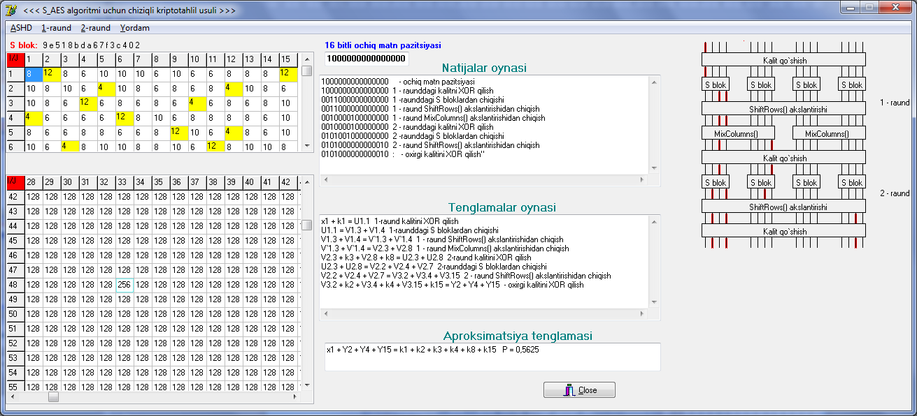
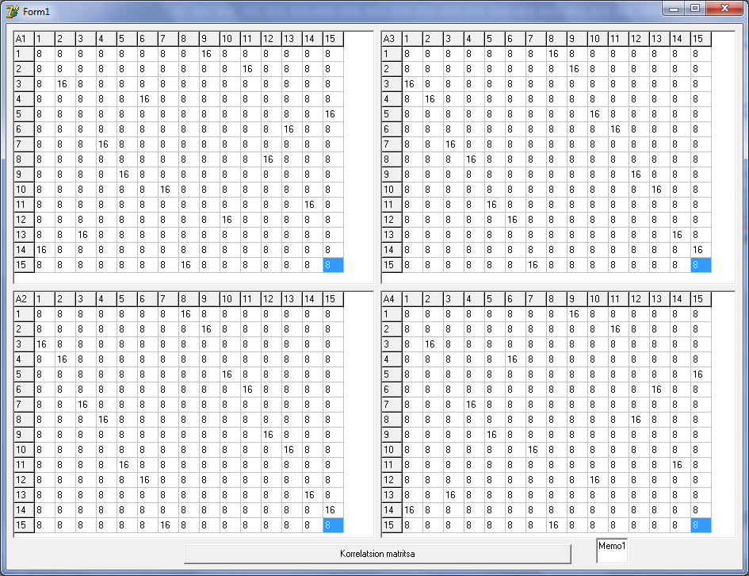
AES o’quv shifrlash algoritmi MixColumns() akslantirishi uchun korrelyatsion matritsasi
S₀ (4 bit)
S₁(4 bit)
00110000
00110000
0011
0011
0000
0000
03
02
02
03
00100001
{03}
{02}
(ha biri 4 bitdan)
00100001
0010
0001
0000
00100001
0000

Slide 17
Ochiq matn
0-raund kaliti
S₁
S₂
S₃
S₄
S₅
S₆
S₇
S₈
S₉
S₁₀
S₁₁
S₁₂
S₁₃
S₁₄
S₁₅
S₁₆
ShiftRows()
P₁
P₂
P₃
P₄
1-raund kaliti
AES standart shimmetrik shifrlash algoritmining 1-raundi uchun ChKT
Kiruvchi x₁ ochiq matn pozitsiyasiga nisbatan AES shifrlash algoritmining 1 – raundiga ChKTni qo’llab, quyidagicha aproksimatsiya tenglamasiga ega bo’linadi:
x₁ + y₇ + y₁₄ + y₂₂ + y₃₀ + y₃₁ = k₁ + k₇ + k₁₄ + k₂₂ + k₃₀ + k₃₁ P = 0,53125

Slide 18
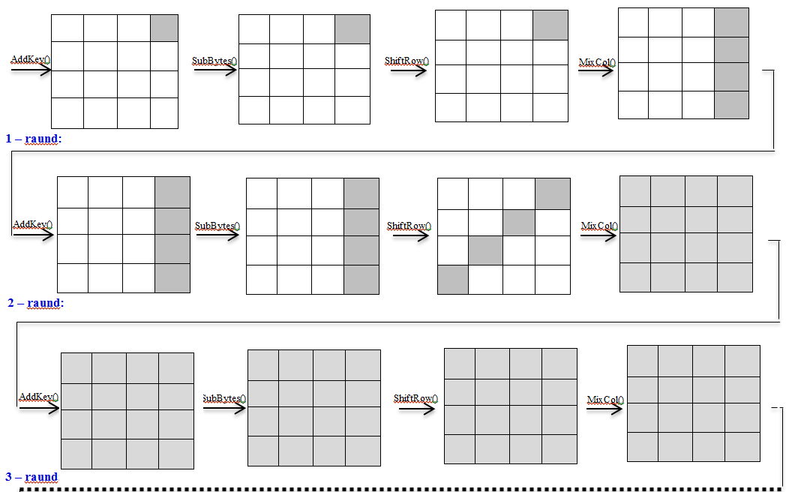
AES standart simmetrik shifrlash algoritmi

Slide 19
AES simmetrik shifrlash algoritmi uchun chiziqli kriptotahlil usuliga dasturiy ta’minotni yaratish
III BOB
3.1
AES o’quv algoritmiga chiziqli kriptotahlil o’tkazish dasturiy ta’minotini yaratish
3.2
AES shifrlash algoritmiga chiziqli kriptotahlil o’tkazish daturiy ta’minotini yaratish

Slide 20
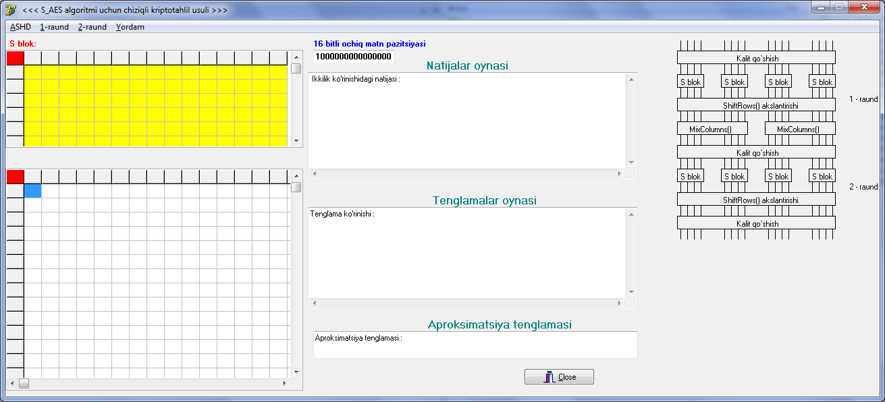
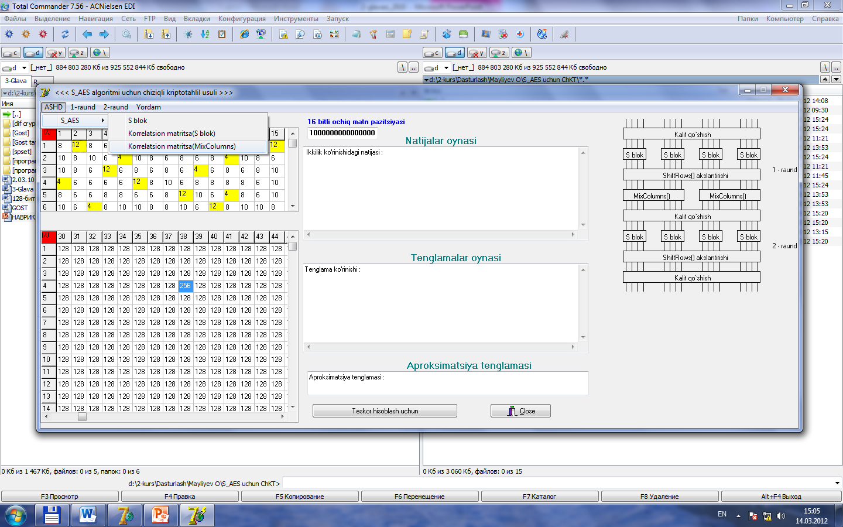
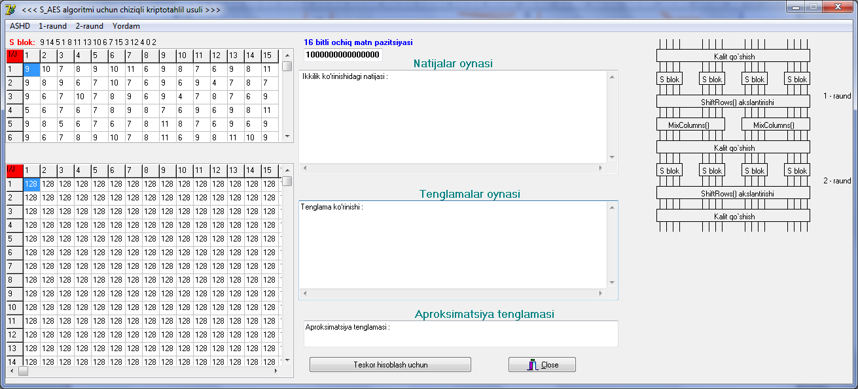
AES o’quv algoritmi uchun chiziqli kriptotahlil usuliga dasturiy ta’minoti

Slide 21
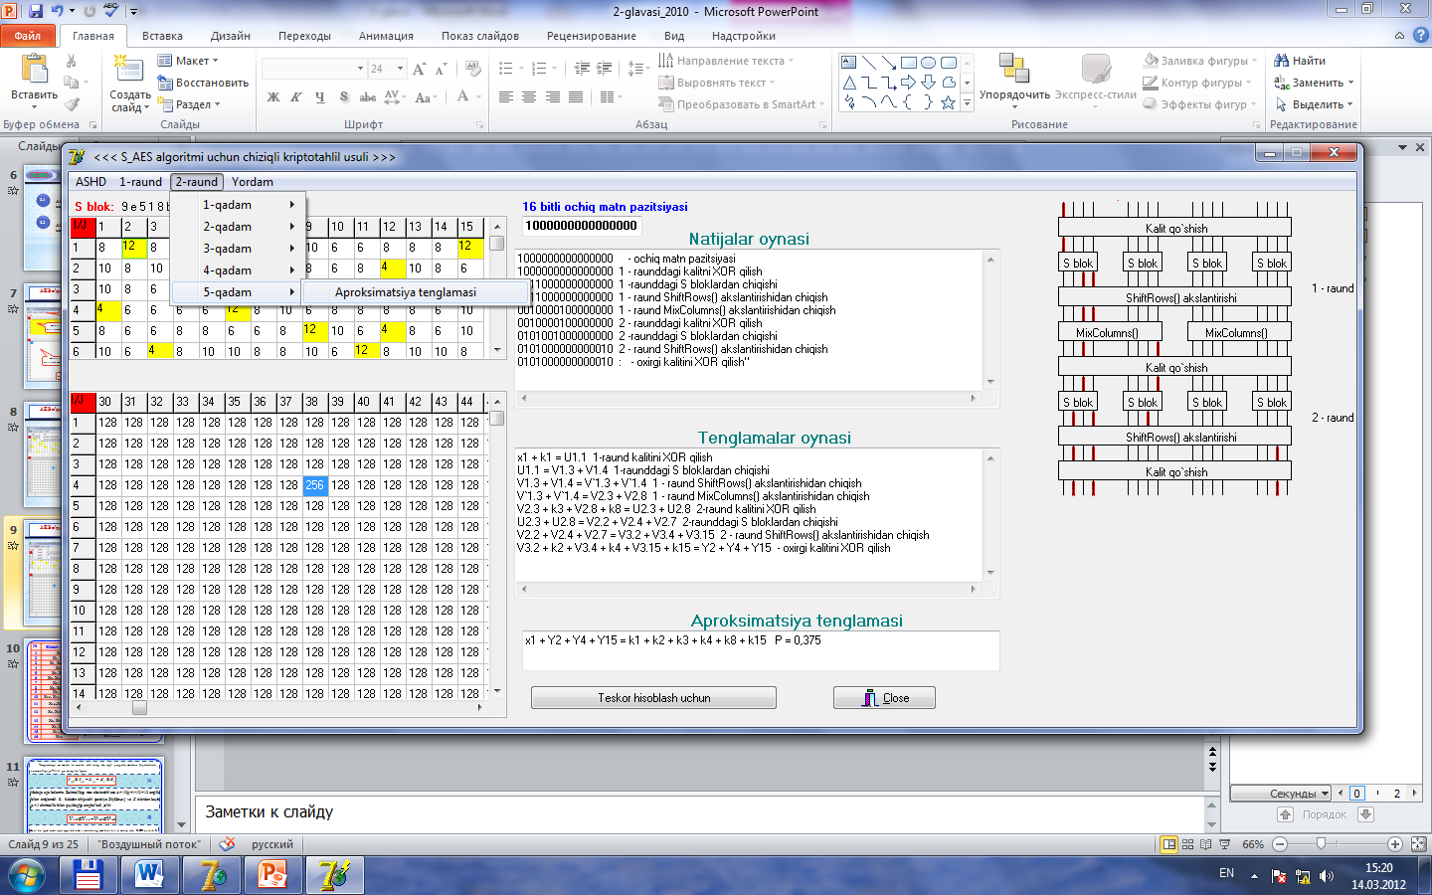
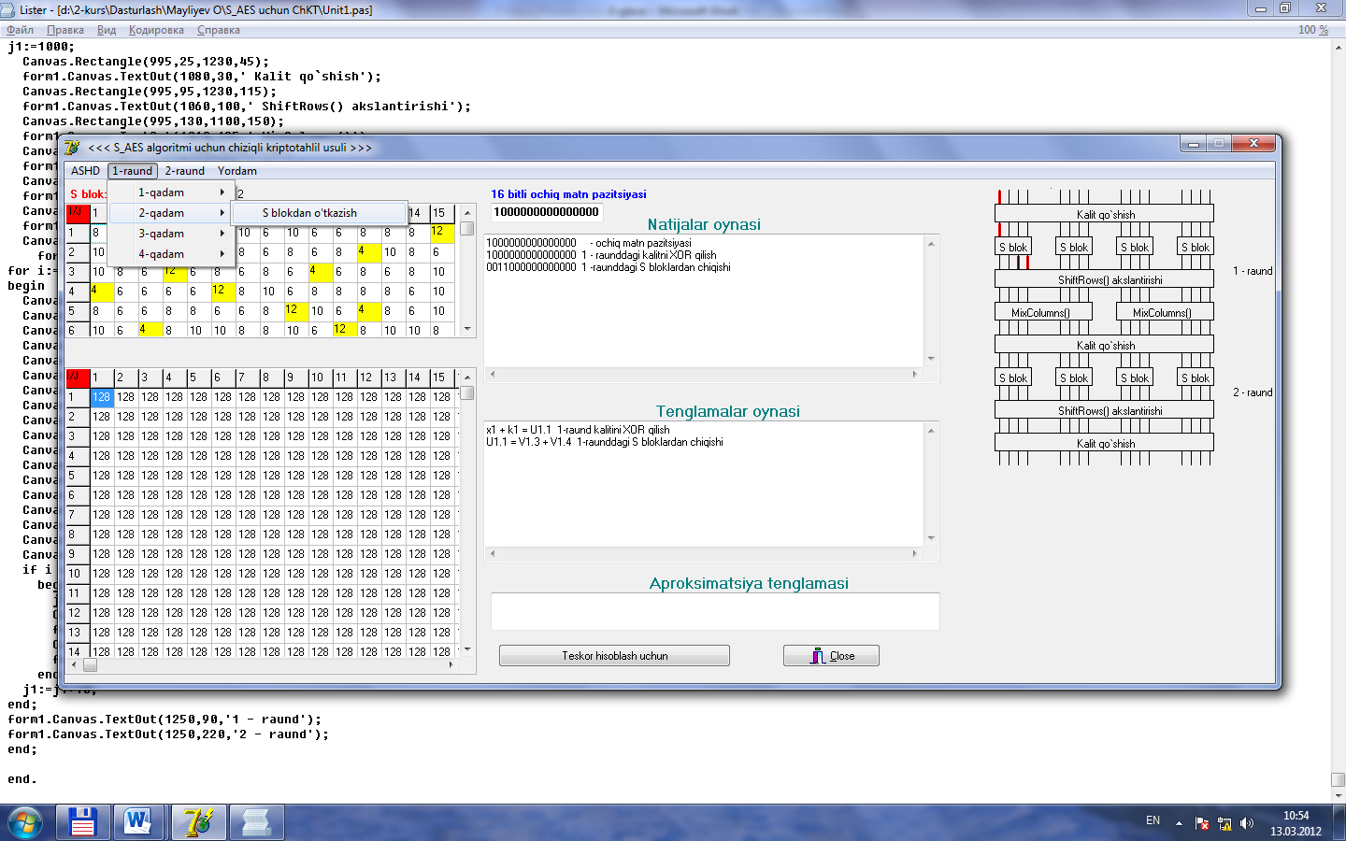
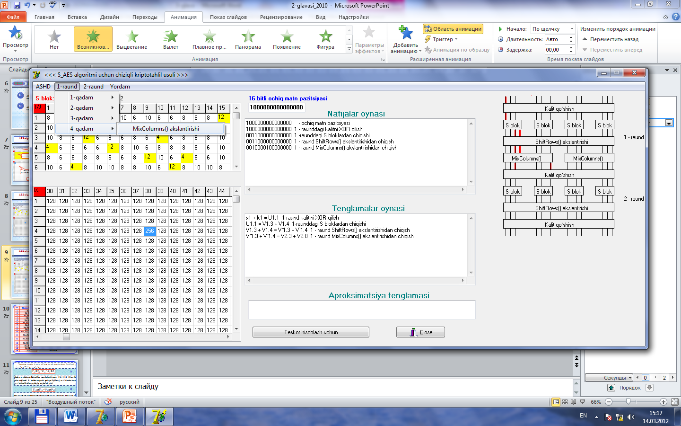
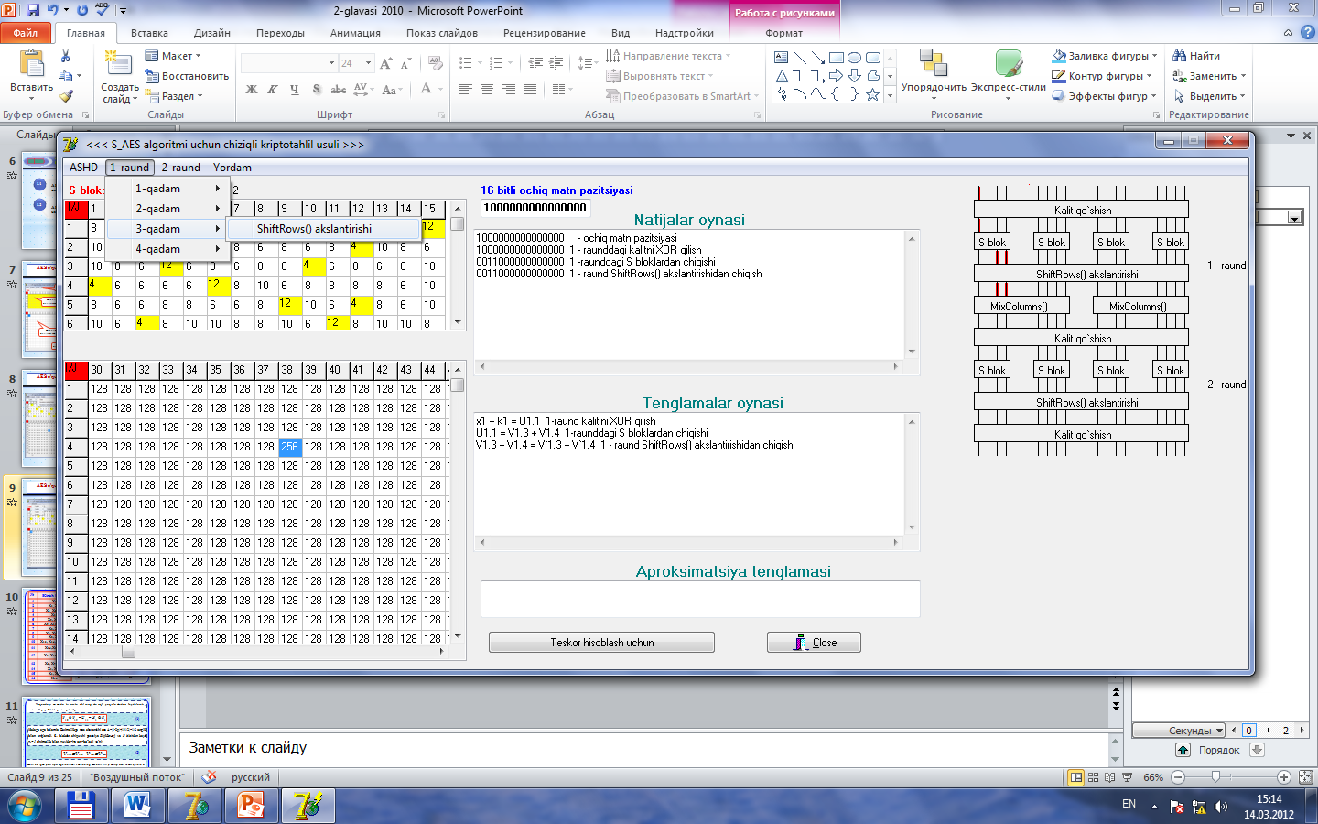
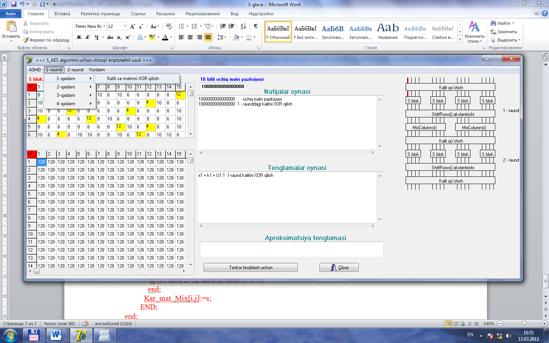
AES o’quv algoritmi uchun chiziqli kriptotahlil usuliga dasturiy ta’minoti
MixColumns() akslantirishi uchun korrelyatsion matritsa jadvali(Pi,i=1,2)

Slide 22
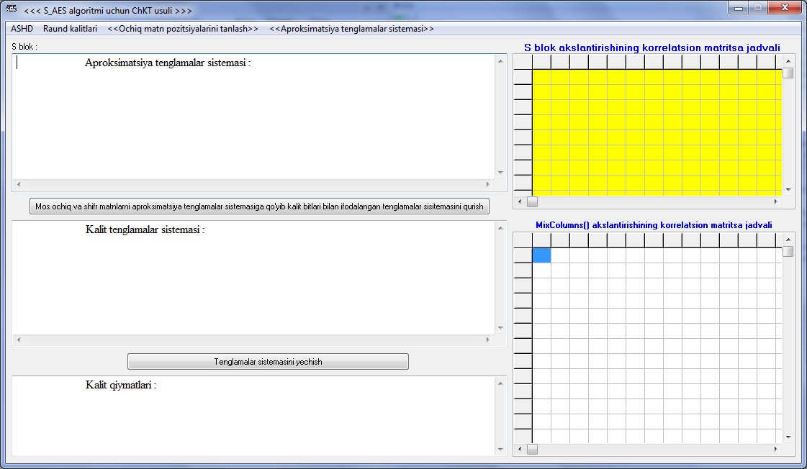
AES o’quv algoritmi uchun chiziqli kriptotahlil usuliga dasturiy ta’minoti

Slide 23
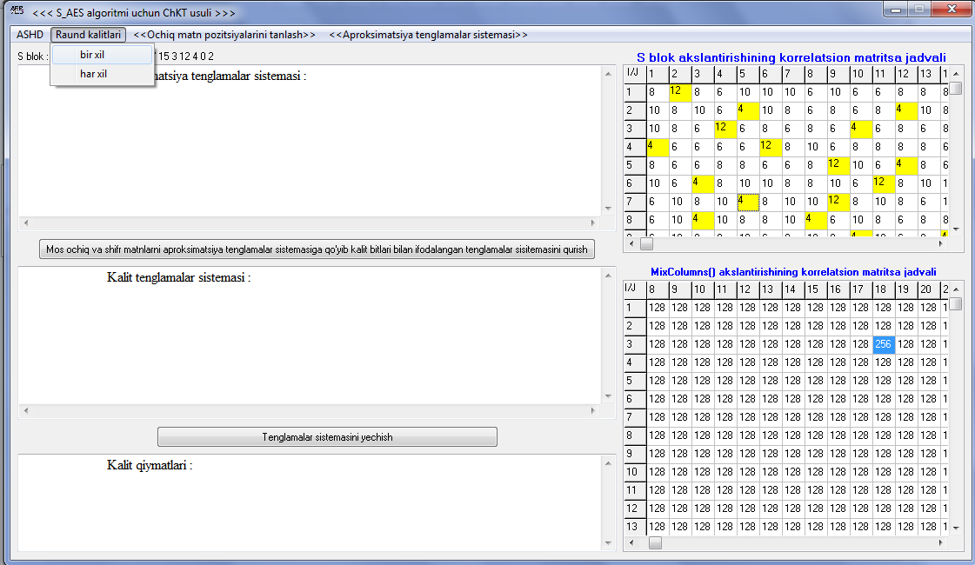
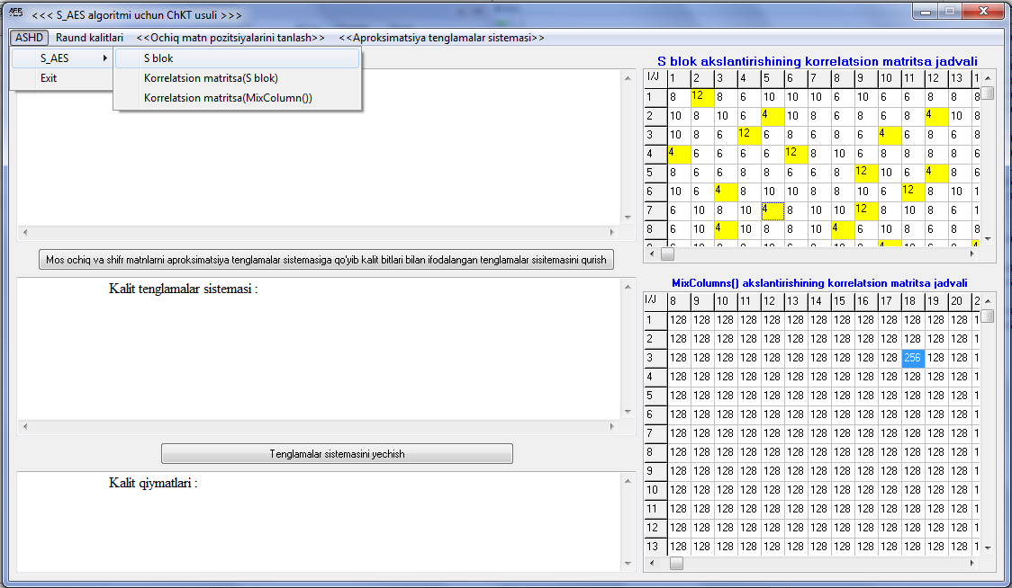
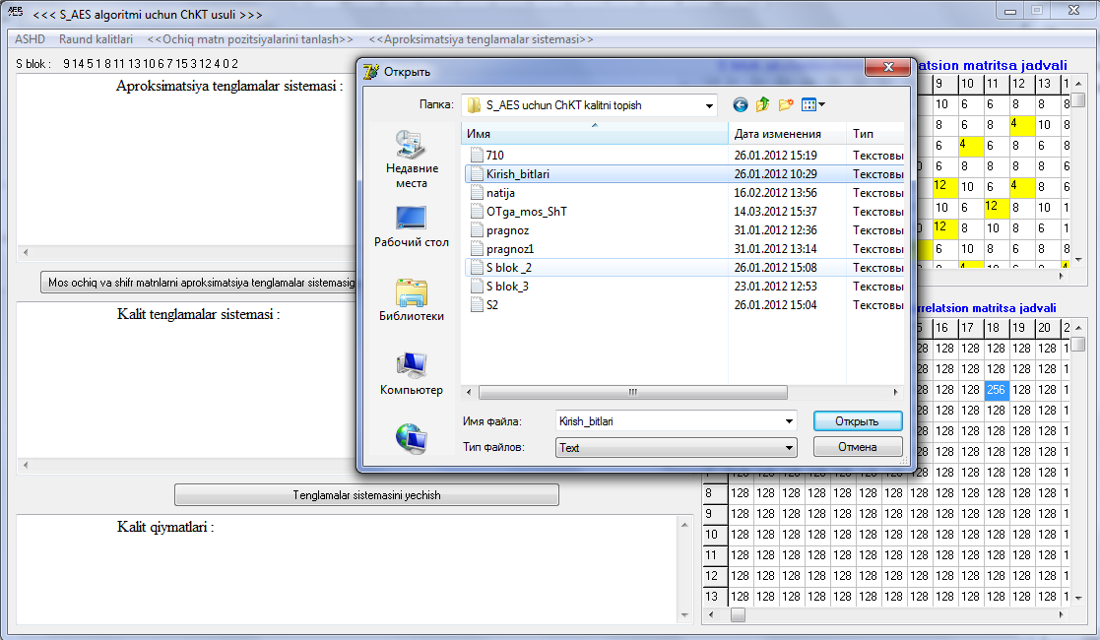
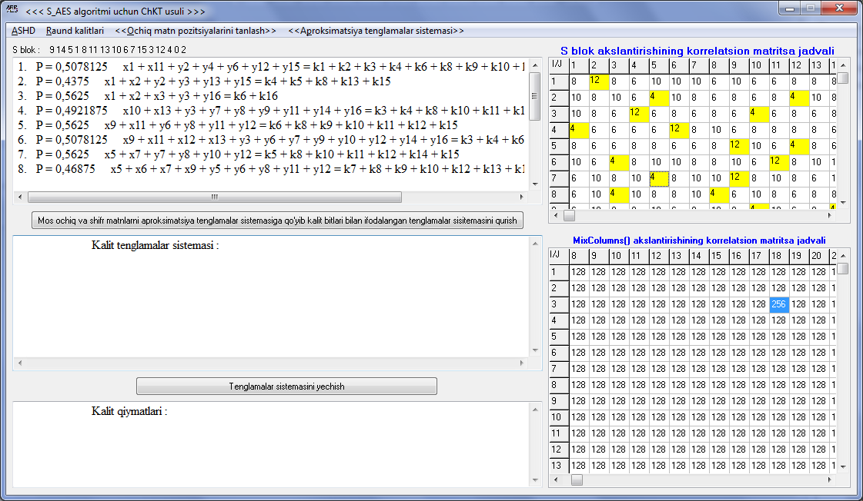
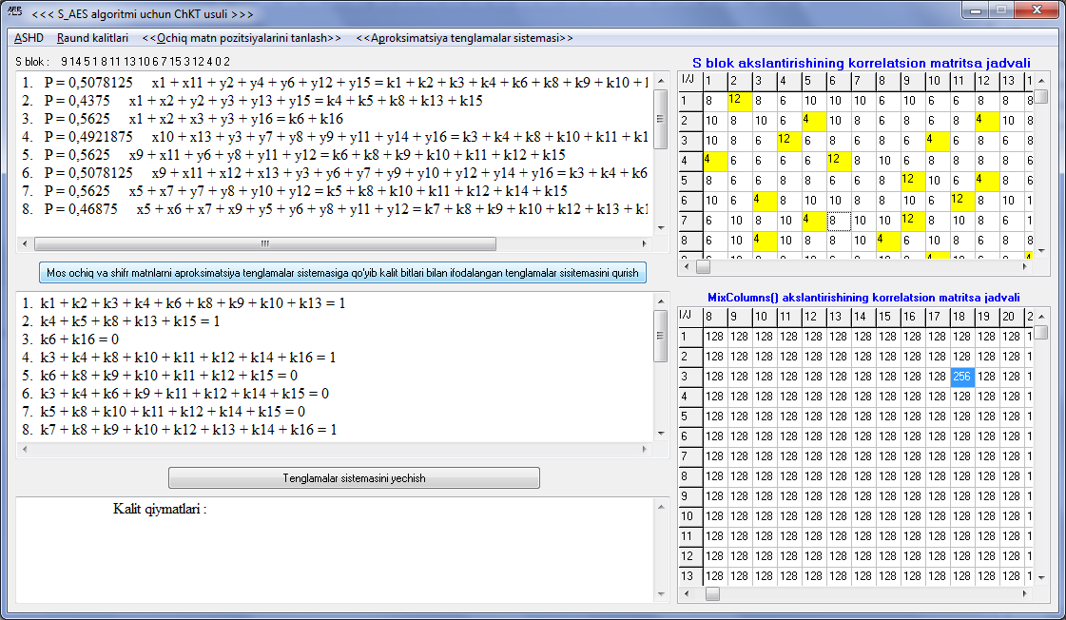
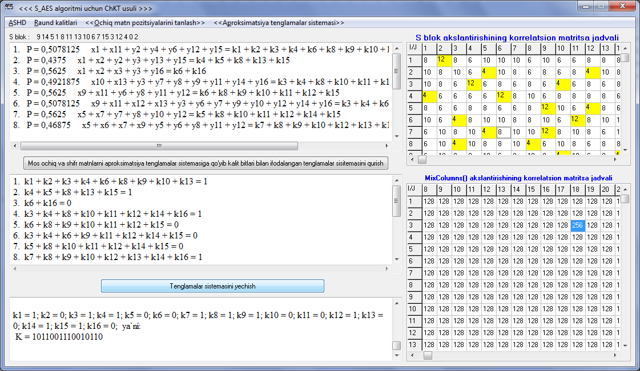
AES o’quv algoritmi uchun chiziqli kriptotahlil usuliga dasturiy ta’minoti

Slide 24
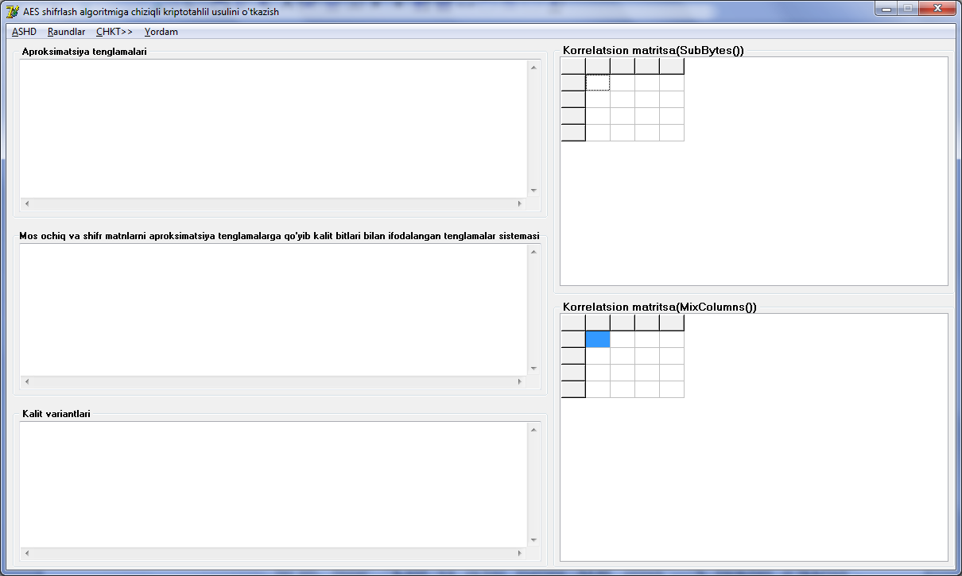
AES algoritmi uchun chiziqli kriptotahlil usuliga dasturiy ta’minoti

Slide 25
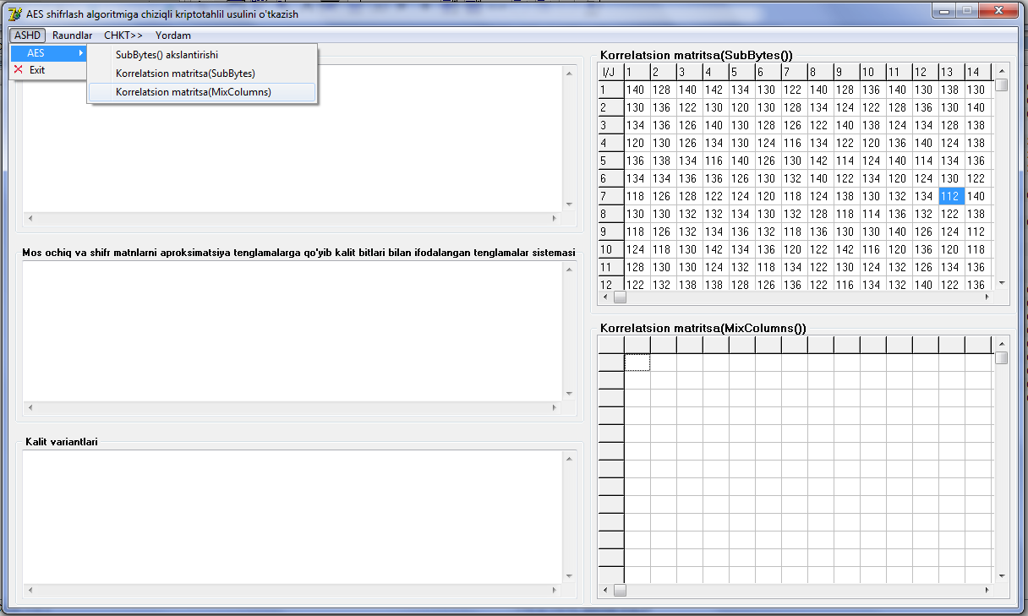
AES algoritmi uchun chiziqli kriptotahlil usuliga dasturiy ta’minoti

Slide 26
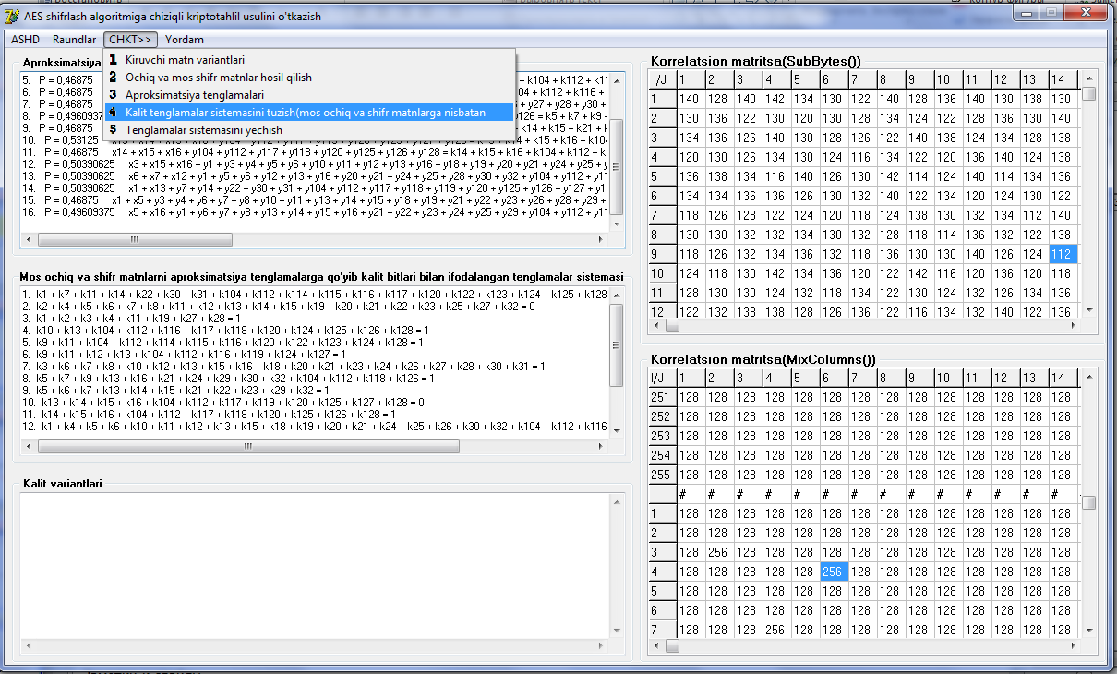
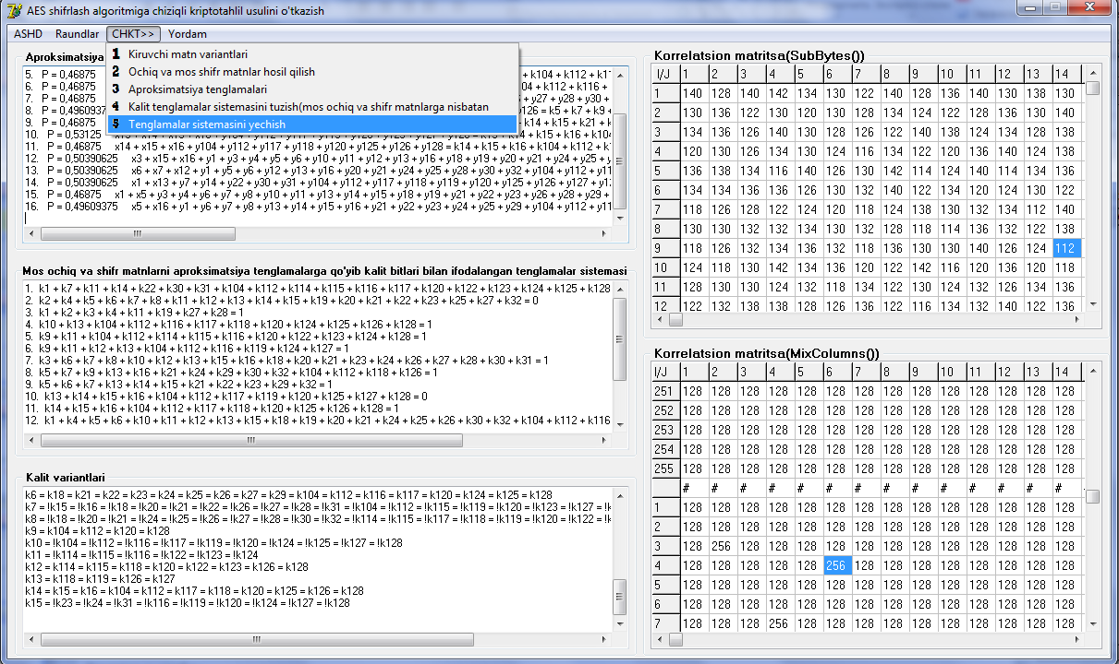
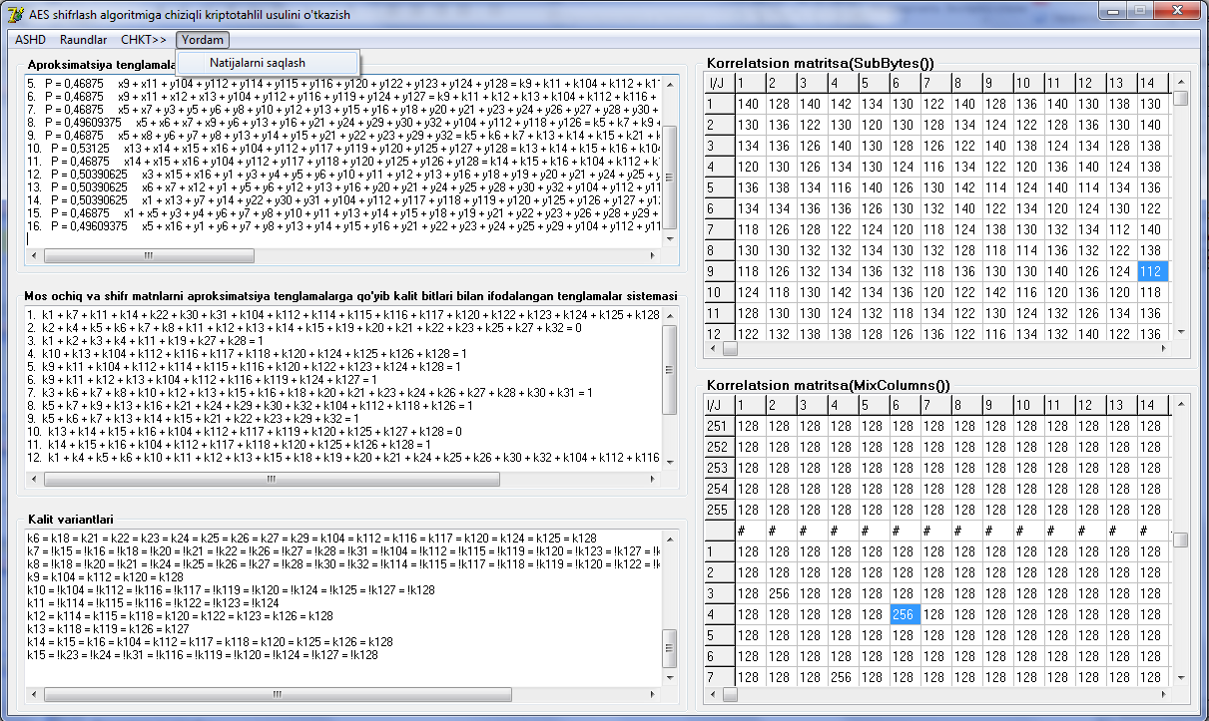
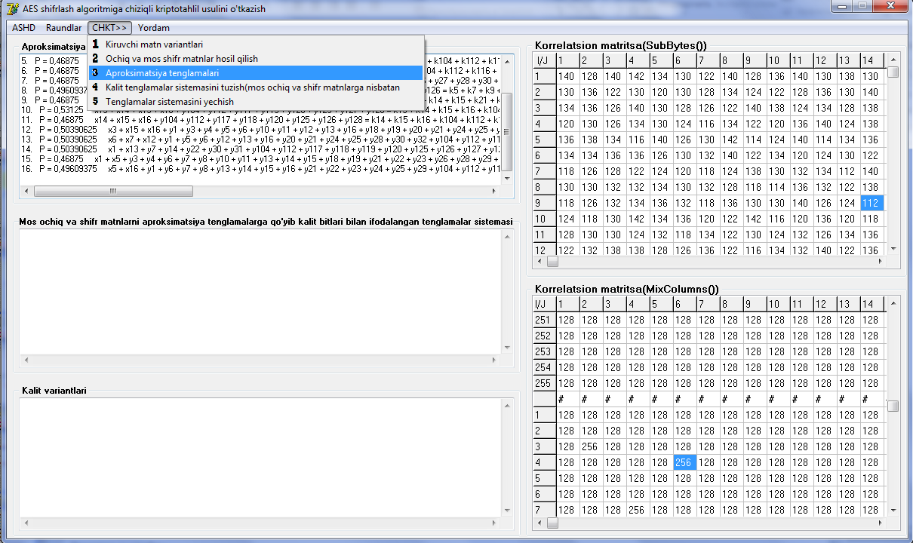
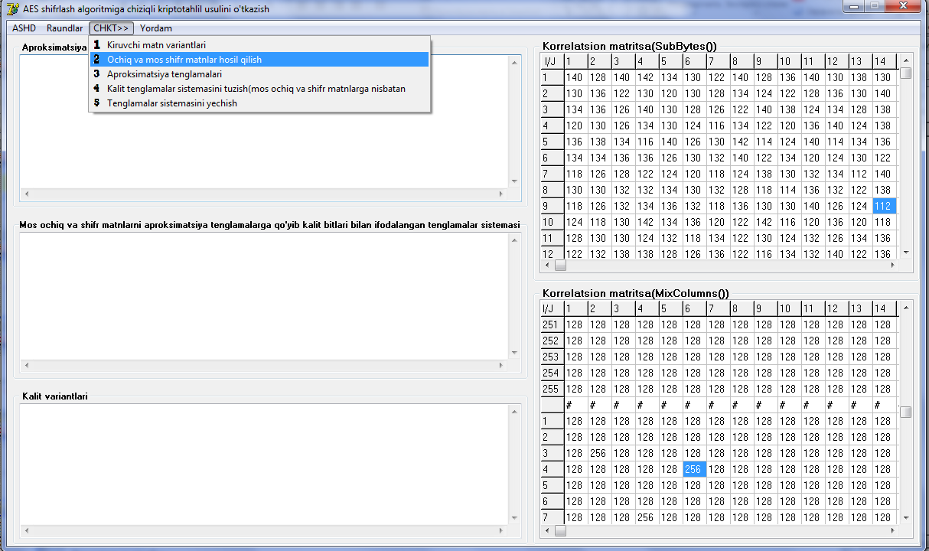
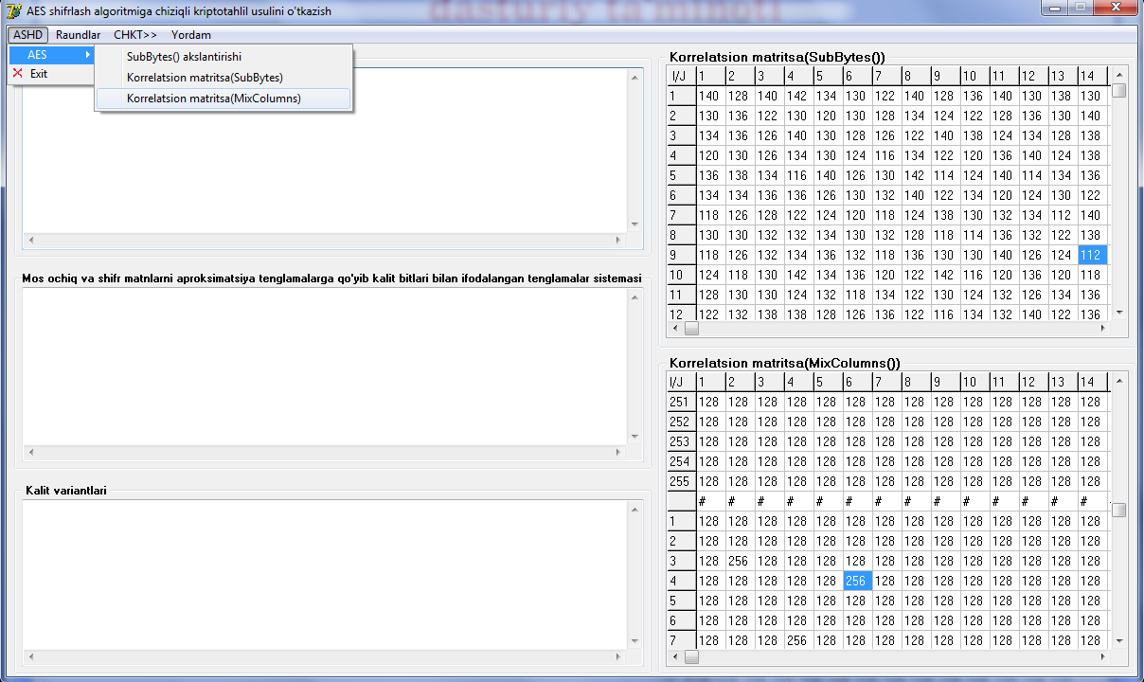
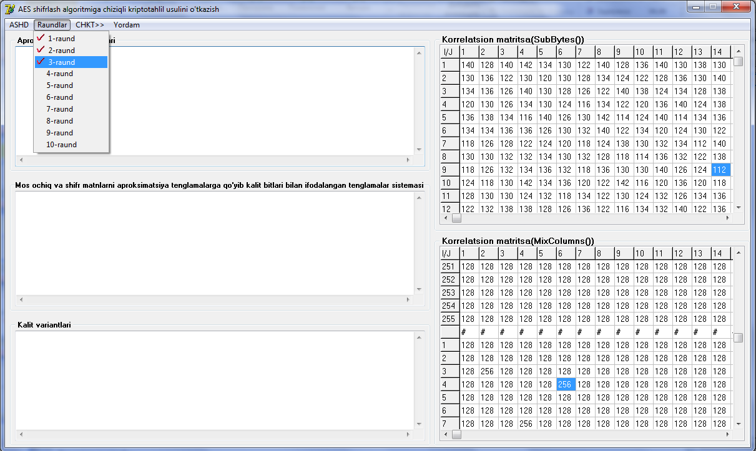
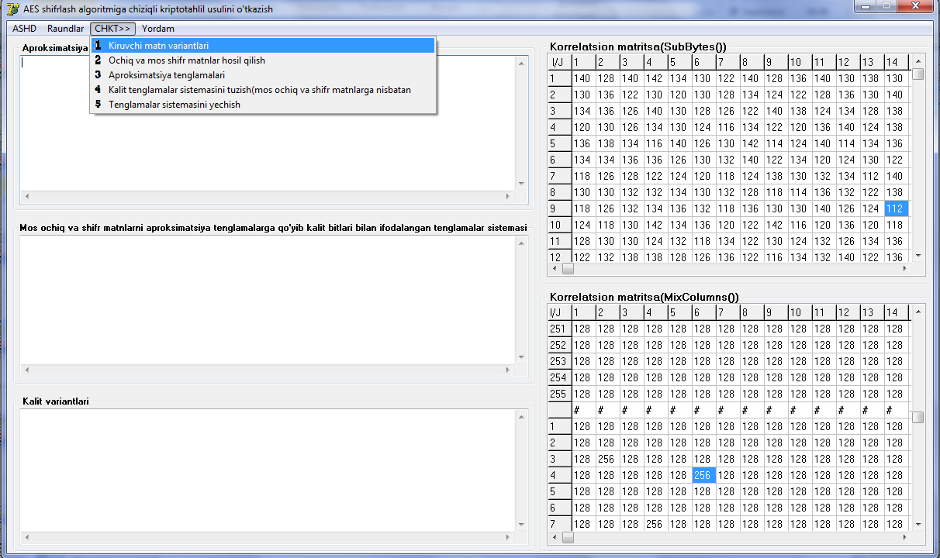
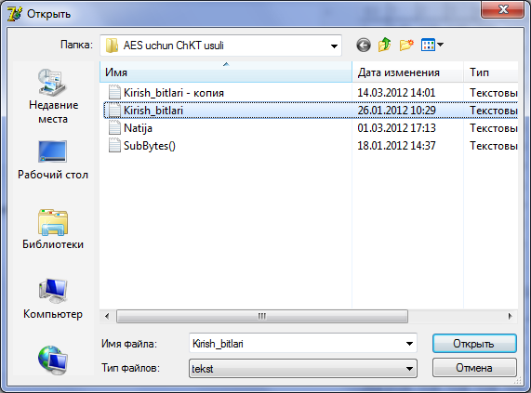
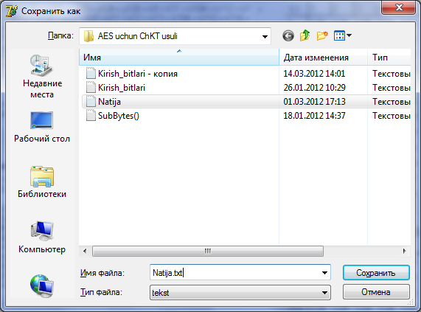
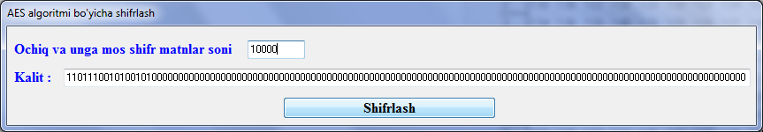
AES algoritmi uchun chiziqli kriptotahlil usuliga dasturiy ta’minoti

Slide 27
IV BOB
AES simmetrik shifrlash algoritmiga chiziqli kriptotahlil usuli uchun yaratilgan dasturiy ta’minotdan olingan natijalar tahlili
4.1
AES o’quv algoritmiga chiziqli kriptotahlil o’tkazish dasturiy ta’minotidan olingan natijalar
4.2
AES shifrlash algoritmiga chiziqli kriptotahlil o’tkazish daturiy ta’minotidan olingan natijalar

Slide 28
AES o’quv algoritmi uchun chiziqli kriptotahlil o’tkazish dasturiy ta’minotini baholash
Quyida keltirilgan jadvallarda algoritmda qo’llanilgan raund kalitlar bir xil bo’lgan holati uchun test natijalari va grafik shakli keltirilgan.
№ | Kiruvchi pozitsiyalar soni |  |  | S1 blok akslantirishi |  |  |  |  |  | S2 blok akslantirishi
 | Kiruvchi-lar soni | Diagonal shaklga keladigan/ soni |  | OT va unga mos SHTlar soni |  |  |  |  |  | OT va unga mos SHTlar soni
 |  |  |  | 2¹⁶ ta | 2¹⁵ ta | 2¹⁴ ta | 5000 ta | 4000 ta | 1000 ta | 2¹⁶ ta | 2¹⁵ ta | 2¹⁴ ta | 5000 ta | 4000 ta | 1000 ta
 |  | S1 | S2
1 | 10000 | 2889 | 2828 | 88 | 19 | 15 | 7 | 5 | - | 584 | 183 | 61 | 4 | 1 | -
2 | 1000 | 277 | 298 | 4 | 1 | 1 | 1 | 1 | - | 71 | 26 | 7 | 1 | - | -
3 | 500 | 147 | 145 | 1 | - | - | - | - | - | 25 | 13 | 2 | - | - | -
4 | 400 | 122 | 115 | 1 | - | - | - | - | - | 21 | 11 | 2 | - | - | -
5 | 300 | 93 | 84 | 1 | - | - | - | - | - | 17 | 11 | 2 | - | - | -
6 | 200 | 65 | 60 | - | - | - | - | - | - | 10 | 8 | 2 | - | - | -
7 | 100 | 37 | 35 | - | - | - | - | - | - | 6 | 3 | - | - | - | -

Slide 29
AES o’quv algoritmi uchun chiziqli kriptotahlil o’tkazish dasturiy ta’minotini baholash
S1 blok(SubBytes()) akslantirishiga nisbatan qiymatlarning grafgi
X – OT va unga mos SHT matn juftliklari soni, Y – kiruvchi ochiq matn pozitsiyalar soni,
Z – Kalit bitlarini bir qiymatli aniqlavchi kiruvchi ochiq matn pozitsiyalar soni.

Slide 30
AES o’quv algoritmi uchun chiziqli kriptotahlil o’tkazish dasturiy ta’minotini baholash
№ | Kiruvchi pozitsiyalar soni |  |  | S1 blok akslantirishi |  |  |  |  |  | S2 blok akslantirishi
 | Kiruvchi-lar soni | Diagonal shaklga keladigan/ soni |  | OT va unga mos SHTlar soni |  |  |  |  |  | OT va unga mos SHTlar soni
 |  |  |  | 2¹⁶ ta | 2¹⁵ ta | 2¹⁴ ta | 5000 ta | 4000 ta | 1000 ta | 2¹⁶ ta | 2¹⁵ ta | 2¹⁴ ta | 5000 ta | 4000 ta | 1000 ta
 |  | S1 | S2
1 | 10000 | 2889 | 2828 | 104 | 18 | 7 | - | - | - | 648 | 267 | 59 | 30 | 22 | 5
2 | 1000 | 277 | 298 | 13 | 2 | 1 | - | - | - | 79 | 28 | 15 | 8 | 3 | -
3 | 500 | 147 | 145 | 5 | - | - | - | - | - | 39 | 11 | 7 | 4 | 1 | -
4 | 400 | 122 | 115 | 5 | - | - | - | - | - | 30 | 9 | 6 | 4 | 1 | -
5 | 300 | 93 | 84 | 3 | - | - | - | - | - | 24 | 8 | 4 | 2 | 1 | -
6 | 200 | 65 | 60 | 2 | - | - | - | - | - | 18 | 5 | 4 | 2 | - | -
7 | 100 | 37 | 35 | - | - | - | - | - | - | 10 | 3 | 3 | 1 | - | -
Kalit biti K₂=1010110001001100₂ bo’lgandagi statistik jadvali

Slide 31
AES algoritmi uchun chiziqli kriptotahlil o’tkazish dasturiy ta’minotini baholash
Yaratilgan dasturiy ta’minotdan foydalanib, X₁ kiruvchi ochiq matn pozitsiyasiga nisbatan ChKTni amalga oshirildi. Birinchi raundlarga nisbatan aproksimatsiya tenglamasi quyidagicha ehtimolliklar bilan hisoblandi:
P = 0,53125 x1 + y7 + y14 + y22 + y30 + y31 = k1 + k7 + k14 + k22 + k30 + k31
№ | Kiruvchi ochiq matn pozitsiyasi | SubBytes() |  |  |  | SubBytes*()
 |  | 1-raund | 2-raund | 3-raund | 4-raund | 1-raund | 2-raund | 3-raund | 4-raund
1 | X₁ | 0,53125 | 0,50000381 | 0,5 | 0,5 | 0,55078125 | 0,5000358 | 0,5 | 0,5
2 | X₁,X₄₄ | 0,49609375 | 0,500000476 | 0,5 | 0,5 | 0,491271972 | 0,4999929 | 0,5 | 0,5
3 | X₃,X₄₁,X₈₇ | 0,5004882 | 0,5000004768 | 0,5 | 0,5 | 0,4983520 | 0,50000539 | 0,5 | 0,5
4 | X₅,X₄₆,X₈₁,X₁₂₁ | 0,499938964 | 0,4999999925 | 0,5 | 0,5 | 0,499667584 | 0,5000002379 | 0,5 | 0,5
5 | X₄,X₉ | 0,500007629 | 0,5000000000 | 0,5 | 0,5 | 0,500072715 | 0,4999999998736 | 0,5 | 0,5
6 | X₁,X₁₀,X₁₇ | 0,50000095 | 0,5 | 0,5 | 0,5 | 0,4999999999 | 0,4999999999999 | 0,5 | 0,5
7 | X₆,X₁₁,X₂₀,X₂₇ | 0,50000011 | 0,5 | 0,5 | 0,5 | 0,4999981587 | 0,5 | 0,5 | 0,5

Slide 32
AES algoritmi uchun chiziqli kriptotahlil o’tkazish dasturiy ta’minotini baholash
Quyidagi jadvalda algoritmning 1 va 2 – raundlariga nisbatan testlash natijalari keltirilgan:
№ | S blok akslantirishlar | Kiruvchi ochiq matn pozitsiyalari soni | Diagonal shaklga keladiganlar soni |  | Aniqlangan kalit bitlari soni
 |  |  | 1-raund | 2-raund | 1-raund | 2-raund
1 | SubBytes() | 100 | 2 | 22 | 58..73 | 59..79
 |  | 1000 | 61 | 222 | 52..76 | 51..83
2 | SubBytes*() | 100 | 35 | 29 | 49..72 | 53..79
 |  | 1000 | 308 | 327 | 48..79 | 47..81
Xulosa 1. AES shifrlash algoritmining 1 va 2-raundlariga ChKT usulini qo’llab natijalar olish mumkin, qachonki kiruvchi ochiq matn pozitsiyalarini effektiv qilib generatsiya qilinsa. Effektiv kiruvchi ochiq matn pozitsiyasini qurish bevosita 2¹²⁸ ta holatlarini ko’rib chiqishni talab etadi. Yuqorida keltirilgan natijalarni “random” funksiyasi yordamida kiruvchi ochiq matn pozitsiyalari generatsiya qilinib, kalit bitlari ma’lum deb qaraganda 50% atrofida to’g’ri aniqlandi.

Slide 33
Xulosa
SP tarmog’i uchun ChKT usulini o’tkazish metodi tahlil qilindi.
AES o’quv va AES algoritmlari uchun ChKT usulini o’tkazish matematik modeli ishlab chiqildi.
AES algoritmi MixColumns() akslantirishi uchun korrelyatsion matritsa qurish masalasi yechildi.
AES o’quv va AES algoritmlari uchun ChKT usulini o’tkazish dasturiy ta’minotlari yaratildi.
AES o’quv algoritmi uchun ChKT usulini o’tkazish dasturiy ta’minotidan olingan natijalar tahliliga ko’ra uning mos raundlarida foydalanilgan 16 bit uzunlikdagi kalitlar bir qiymatli topiladi.
AES simmetrik shifrlash algoritmida foydalanilgan SubBytes() akslantirishining chiziqsizlik qiymati yuqori hamda MixColumns() funksiyasi bitlarni maksimal aralashtiradi, bu esa raundda ishlatilgan kalit bitlarini chiziqli kriptotahlil usuli bilan topish imkoniyatini murakkablashtiradi.
AES algoritmi uchun ChKT usulini o’tkazish dasturiy ta’minotidan olingan tahlil natijalariga ko’ra uch va undan yuqori bo’lgan raundlarga nisbatan qurilgan aproksimatsiya tenglamalari P=1/2 ehtimollik bilan bajarilishi aniqlandi.
AES algoritmining birinchi va ikkinchi raundlariga ChKT usulini amalga oshirish bevosita kiruvchi ochiq matn pozitsiyalarini effektiv qilib tanlash, hosil qilingan kalit tenglamalar sistemasini effektiv yechish usullarini ishlab chiqish bilan xarakterlanadi.
Ushbu dissertatsiya ishida olingan ilmiy natijalar mavjud va milliy standart simmetrik shifrlash algoritmlarini zamonaviy kriptotahlil usullariga bardoshligini baholash masalarida foydalanish mumkin.
Kelajakda mazkur yo’nalishdagi ilmiy ishlarning uzviy davomi sifatida AES algoritmiga ChKT usulini o’tkazishning effektiv elementi hisoblangan kirish pozitsiyasi bitlarini tanlash, ochiq va unga mos shifr matnlar sonini aniqlash hamda kalitga nisbatan hosil qilingan tenglamalar sistemasini yechishning effektiv usullarini tadqiq qilish maqsadga muvofiq.

